Slide 1

CIST 2931, Fall 2016 Weekly Report #2 10/10/2016
i c i o u s
Cnrl/alt/Delicious
Steven Alcorn, Zachary Weaver, Tyrus Skipper, Antonio Mosquera, Rupa Shrestha
Notes:
Antonio

Slide 2
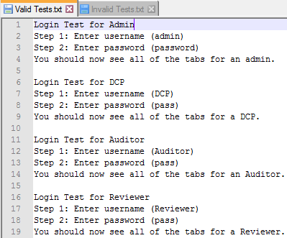
Tests
i c i o u s
Notes:
Antonio

Slide 3
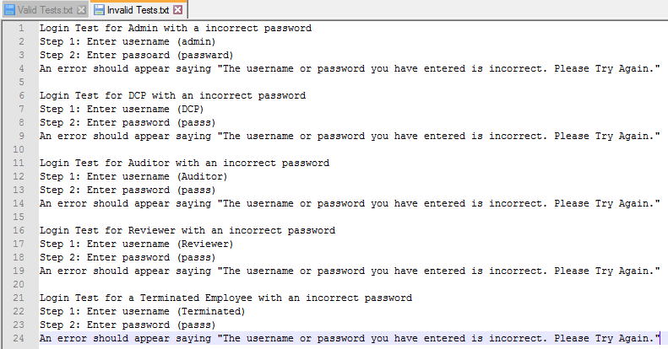
Tests
i c i o u s
Notes:
Antonio

Slide 4
Code
i c i o u s
Created a notification for pressing the delete button when a saved not is not selected
Created a notification for asking the user if they are sure to delete a saved note
Created a method to fix the duplicate note saving issue
Modified the code to transition properly when an Admin or DCP would open a saved note.
Notes:
Zach

Slide 5
//Displays a message to the user to select a note to delete if they click
//the delete button with the default option selected.
if("Saved Notes...".equals(selectedItem)){
JOptionPane.showMessageDialog(null, "Please select a note to delete.");
}
else if(!"Saved Notes...".equals(selectedItem)){
//Displays a notification asking the user if they are sure to delete
//a saved note
int selectedOption = JOptionPane.showConfirmDialog(null,
"Are you sure you want to delete the note?",
"Delete Note?",
JOptionPane.YES_NO_OPTION);
if (selectedOption == JOptionPane.YES_OPTION) {
try {
int selectedNoteID = Integer.parseInt(selectedItem.split(":")[0]);
NoteDBConnect.deleteDraft(selectedNoteID);
populateSavedNoteList(NoteDBConnect.getSavedDraft(activeUser));
} catch (SQLException ex) {
Logger.getLogger(AdminForm.class.getName()).log(Level.SEVERE, null, ex);
} catch (ClassNotFoundException ex) {
Logger.getLogger(AdminForm.class.getName()).log(Level.SEVERE, null, ex);
}
Notes:
Zach

Slide 6
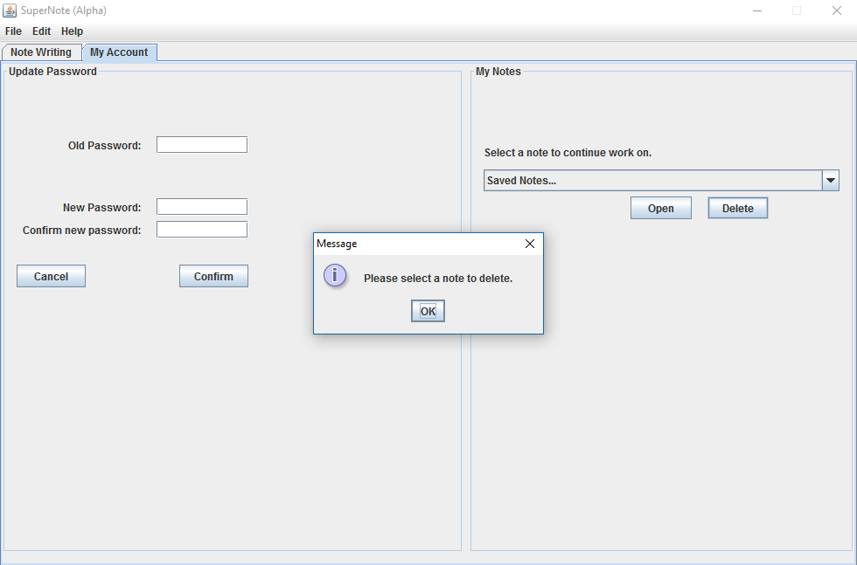
Notes:
Zach

Slide 7
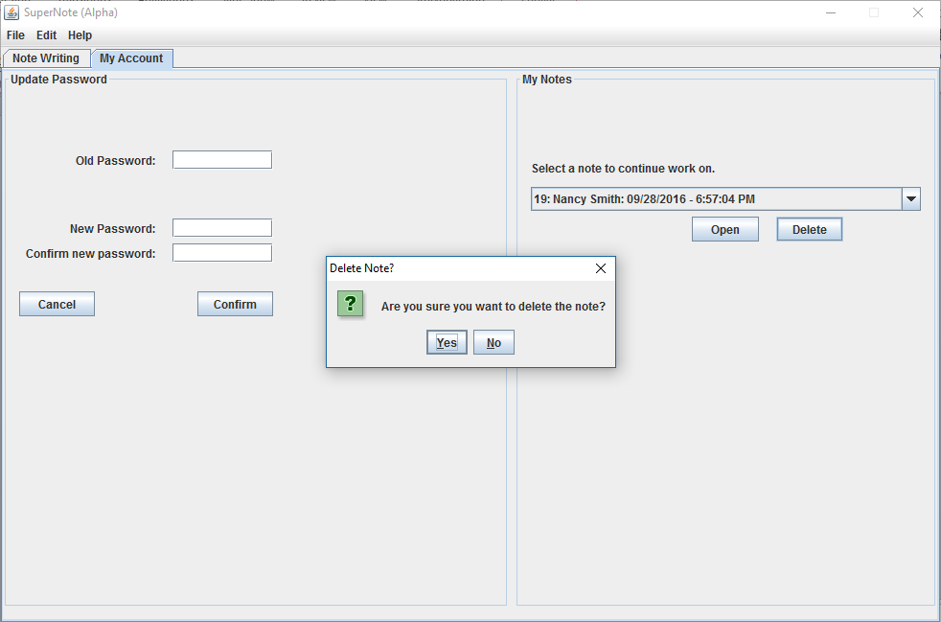
Notes:
Zach

Slide 8
Project Plan
i c i o u s
Fix the issue of saving a note without overwriting a current note with a New Note button.
Fix the Reject button for the Note Reviewer.
Notes:
Ty

Slide 9
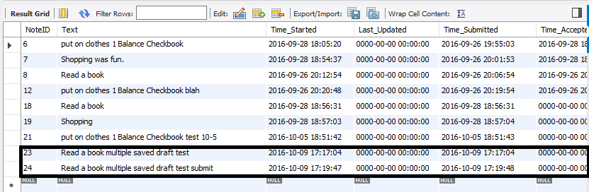
i c i o u s
Notes:
Ty

Slide 10
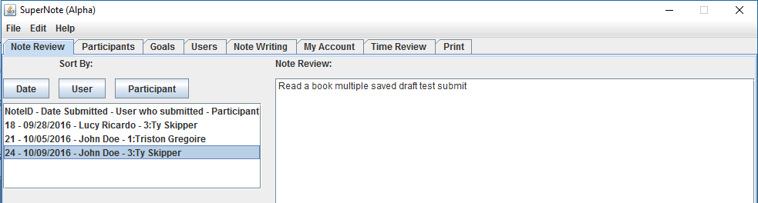
i c i o u s
Notes:
Ty

Slide 11
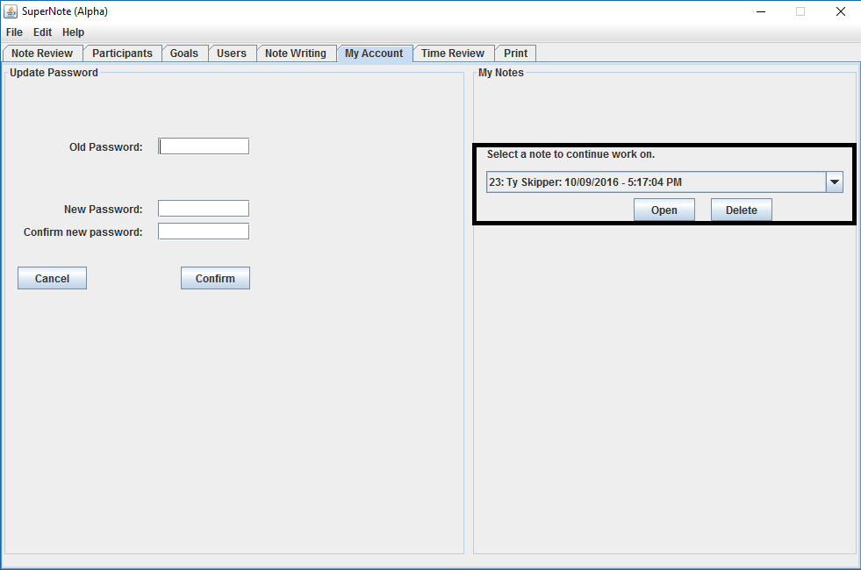
i c i o u s
Notes:
Ty

Slide 12
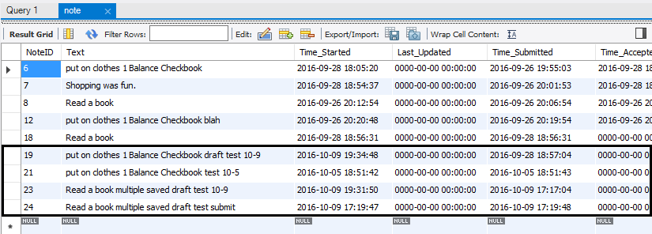
i c i o u s
Notes:
Ty

Slide 13
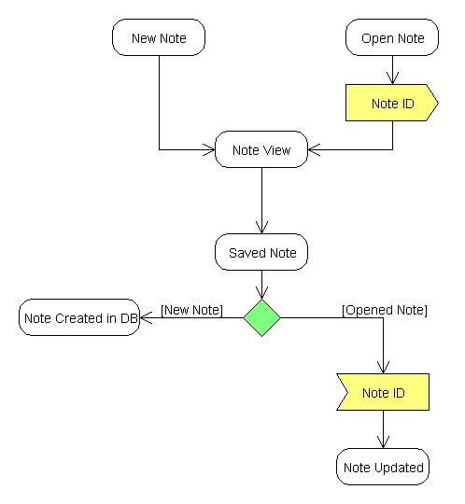
Deliverable
i c i o u s
Notes:
Steven

Slide 14
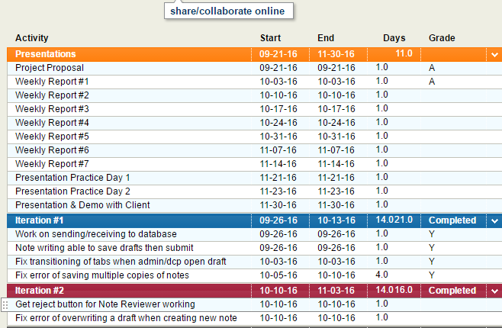
Project Plan for the Semester
Notes:
Rupa

